Slide 1

Database Systems: Phase 3 Presentation
By Kris Pichon & Zion Kondou

Slide 2
System Description
This project implements a database-driven Conference Management System that supports:
Organizing conferences, sessions, rooms, speakers, and schedules
Managing room availability using independent room time slots
Assigning sessions to room schedules through a many-to-many bridge
Tracking administrative activity through logging
The system is designed following a fully normalized relational model and provides an interactive application layer for performing scheduling and administrative tasks.

Slide 3
Use-Case Description
Our system supports the following core use cases:
Admin / Scheduler Use Cases:
Create and manage conferences
Create new sessions
Assign speakers to sessions
Assign sessions to room schedule slots
Update room availability status
Review system logs

Slide 4
Use-Case Description (Continued)
User/Viewer Use Cases:
View all conferences
View sessions within a conference
View available rooms and schedules by date

Slide 5
E/R Diagram
Our E/R design includes eight entities and models two key many-to-many relationships via associative tables:
Relationship Highlights:
Conference → Session (1:N)
Room → RoomSchedule (1:N)
Session ↔ RoomSchedule via SessionRoomAssignment (M:N)
Session ↔ Speaker via SpeakerAssignment (M:N)
RoomSchedule → LogEntry (1:N)

Slide 6
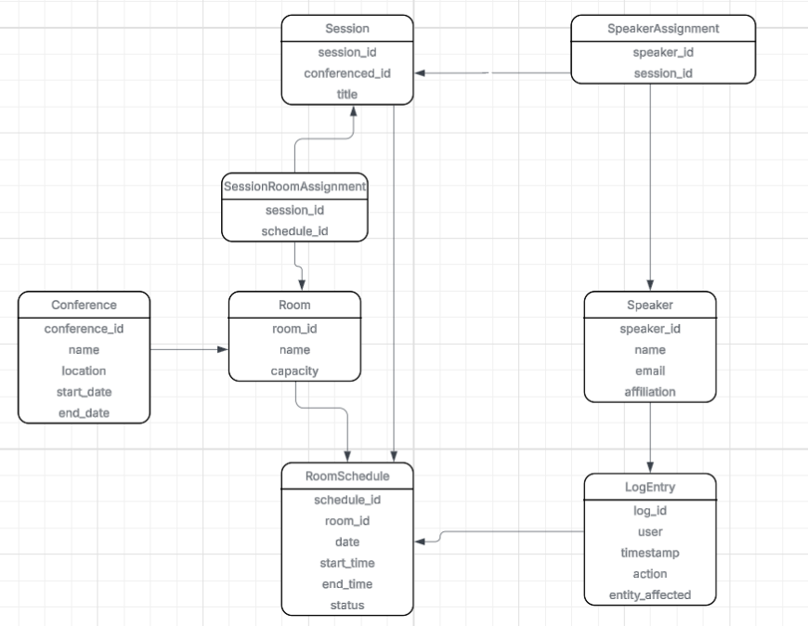
E/R Diagram
The E/R diagram that represents the logical structure of the database
This ensures the design stays normalized and avoids redundant data.
8 Entities :
Conference
Session
Room
RoomSchedule
SessionRoomAssignment
Speaker
SpeakerAssignment
LogEntry

Slide 7
E/R Diagram
5. RoomSchedule → SessionRoomAssignment
(One-to-Many)
6. Session ↔ RoomSchedule (Many-to-Many via SessionRoomAssignment)
7. Speaker → SpeakerAssignment (One-to-Many)
8. Session ↔ Speaker
(Many-to-Many via
SpeakerAssignment)
8 relationships:
6 one-to-many,
2 many-to-many
1. Conference → Session (One-to-Many)
2. Room → RoomSchedule (One-to-Many)
3. RoomSchedule → LogEntry
(One-to-Many)
4. Session → SessionRoomAssignment (One-to-Many)

Slide 8
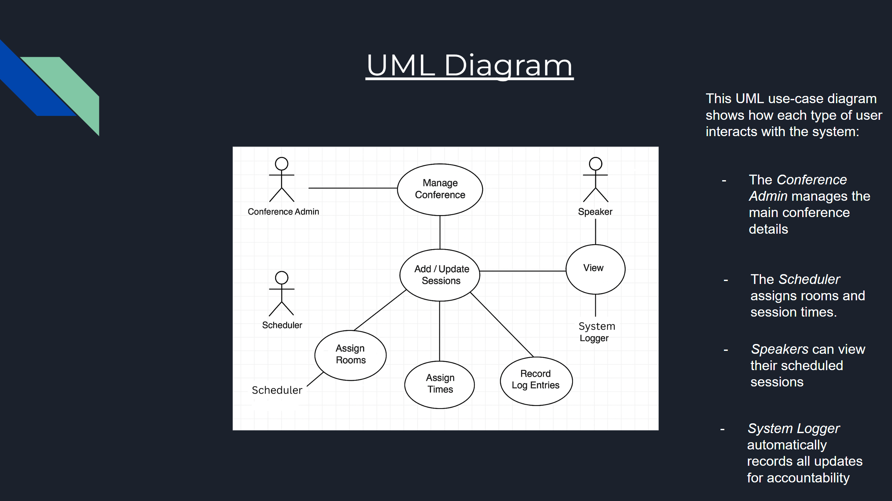

Slide 9
Relational Schema
The database was implemented in SQLite using eight normalized tables:
Conference(conference_id PK, …)
Session(session_id PK, conference_id FK, …)
Room(room_id PK, …)
RoomSchedule(schedule_id PK, room_id FK, date, start_time, end_time, status)
SessionRoomAssignment(session_id FK, schedule_id FK, PK(session_id, schedule_id))
Speaker(speaker_id PK, …)
SpeakerAssignment(session_id FK, speaker_id FK, PK(session_id, speaker_id))
LogEntry(log_id PK, timestamp, action, entity_affected)
All foreign keys match the relationships defined in the E/R diagram.

Slide 10
Implementation Details
We populated the system with representative sample data including:
Conferences and event dates
Multiple sessions under each conference
Several rooms with defined capacities
Independent room scheduling slots
Speaker profiles and assignments
Session scheduling assignments
System-generated log entries
This dataset enables meaningful testing and realistic demonstration of application functionality.

Slide 11



Application Layer
We created a Python CLI application (app.py) to provide an interactive front-end for database operations. Features include:
Menu-driven interface
User input for parameters (conference_id, session_id, schedule_id, dates, etc.)
Modular functions mapping directly to system use cases
Automatic logging of schedule updates
This application simulates a functional administrative console for conference scheduling.

Slide 12

Important Features Demo
The application demonstrates:
Data Retrieval:
List all conferences
View sessions under a specific conference
View room schedules filtered by date
Display all speakers and speaker assignments

Slide 13
Important Features Demo
Data Modification:
Add new sessions
Assign speakers to sessions
Assign sessions to room time slots
Update room schedule status (Available → Reserved → Completed)

Slide 14
Important Features Demo
Logging:
Automatically writes updates to the LogEntry table
Allows review of all system changes in chronological order

Slide 15

Example SQL Operations
Examples of SQL operations executed through Python:
-- Update schedule status
UPDATE RoomSchedule SET status = ? WHERE schedule_id = ?;
-- Assign speaker to session
INSERT INTO SpeakerAssignment (session_id, speaker_id)
VALUES (?, ?);
-- Find room schedule for a given date
SELECT * FROM RoomSchedule WHERE date = ?;
-- Insert new session
INSERT INTO Session (session_id, conference_id, title)
VALUES (?, ?, ?);
All operations use placeholders (?) filled with user-provided input at runtime

Slide 16
Demonstration Plan
During the demo, we will showcase the following sequence:
List all conferences
View sessions for a selected conference
View room schedules by date
Add a new session (user input)
Assign a speaker to the new session
Assign the session to a room scheduling slot
Update a room schedule status
Display log entries confirming updates
This demonstrates full-cycle functionality from creation → scheduling → logging.

Slide 17
Summary
Our conference management system integrates:
A normalized relational database (8 entities)
A complete SQL schema and sample dataset
A Python-based interactive application
Full support for scheduling, speaker assignment, logging, and data lookup
This satisfies all requirements across Phases 1, 2, and 3 and demonstrates a functional database-backed management system.

Slide 18
Github Repository
The GitHub repository contains:
conference_database.sql — schema + sample data
queries.sql — query demonstration script
app.py — interactive application layer
README.md — documentation and setup instructions
/slides — presentation files

Slide 19
The End!
Thank you for your time. We are happy to answer any questions about the database design, implementation, or application.

